Slide 1



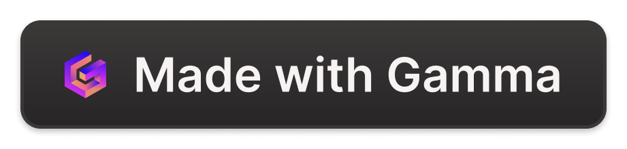
Myntra: Reinventing Fashion for Gen Z
Myntra faces the challenge of staying relevant and engaging with the ever-evolving preferences of Gen Z, who are digital natives and social media enthusiasts. They demand personalized experiences and a seamless integration of fashion and social connections.
by Jhanvi Jain

Slide 2
The Problem: Lack of Social Integration
1
Limited Social Interaction
2
Missed Opportunities for Engagement
Current e-commerce platforms often lack meaningful social integration, failing to cater to Gen Z's desire for shared experiences and community-driven shopping.
Without interactive features, users are left with a passive experience, leading to decreased engagement and brand loyalty.
3
Lack of User-Generated Content
4
Missed Opportunities for Discovery
The absence of platforms for user-generated content limits the potential for organic content creation and viral trends.
Users rely on traditional browsing methods, missing out on personalized recommendations and curated content tailored to their interests.

Slide 3
The Impact: Lost Revenue and Customer Retention
Decreased Conversion Rates
Reduced Brand Loyalty
Missed Opportunities for Growth
Without a strong social component, users are less likely to feel a sense of connection with the brand, leading to decreased loyalty and repeat purchases.
Limited social engagement translates to lower conversion rates, as users hesitate to make purchases without social validation or peer recommendations.
Failure to capitalize on the potential of social commerce hinders the platform's ability to attract new users and expand its market share.

Slide 4

The Solution: A Socially Integrated Fashion Experience
Live Video Shopping
Virtual Wardrobe
Shoppable Social Media Integration
Host interactive live streams featuring fashion shows, product launches, and influencer collaborations to create an immersive shopping experience.
Enable users to create and share personalized virtual wardrobes, allowing them to style outfits, get feedback, and discover new trends.
Integrate shoppable posts, influencer collaborations, and user-generated content to seamlessly connect social media with the shopping experience.

Slide 5




Feasibility and Implementation
Existing Infrastructure
Partnerships
User Testing
Leverage Myntra's existing infrastructure and technical expertise to expedite the development and integration of new features.
Collaborate with social media platforms and leading influencers to amplify reach and create a buzz around the new features.
Conduct thorough user testing to ensure seamless integration and optimal user experience before the public launch.

Slide 6
Benefits of Social Integration
Increased User Engagement
Enhanced Customer Loyalty
Higher Conversion Rates
Stronger Brand Identity
Expanded Market Reach
Improved Customer Acquisition

